Slide 1
Amazon Elastic Load Balancer

Slide 2
Amazon Elastic Load Balancer (ELB)
Supports the routing and load balancing of HTTP, HTTPS and TPC traffic to EC2 instances
Supports health checks to detect and remove failing instances
Dynamically grows and shrinks based on traffic
Seamlessly integrates with Auto-scaling to add and remove instances based on scaling activities

Slide 3
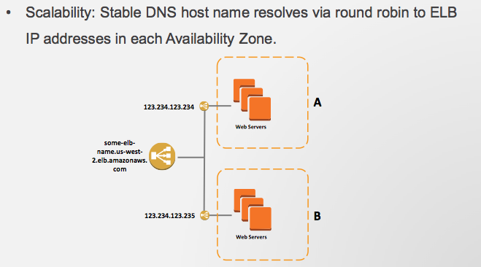
Single CNAME per ELB
Single CNAME (canonical name) provides stable entry point for DNS configuration
To the outside world everything behind the load balancer is just one machine with a single name.
Never refer to an ELB by its IP Address. Always uses its CName
The following example associates an alias with a CNAME
www.foo.example.com CNAME myLB-1234567890.us-east-1.elb.amazonaws.com
myLB-1234567890.us-east-1.elb.amazonaws.com
CNAME

Slide 4
Distribute Load Across Availability Zones
ELB can be used to distribute load across different availability zones of the same region

Slide 5
Health Checks
The ELB can be used to perform health checks on the servers
If a server is unhealthy then future requests will be diverted away from it
Example way to perform health checks
HTTP Get /health.php
Every x seconds
Instance marked unhealthy after y consecutive failures

Slide 6
Amazon Elastic Load Balancer (ELB)

Slide 7
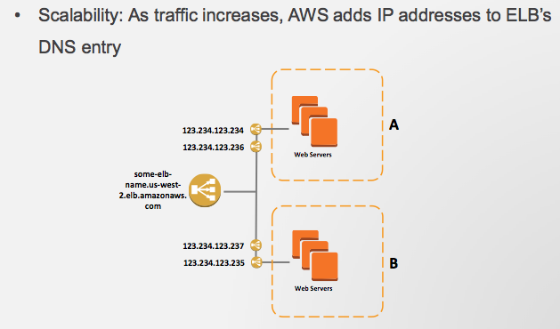
Amazon Elastic Load Balancer (ELB)

Slide 8
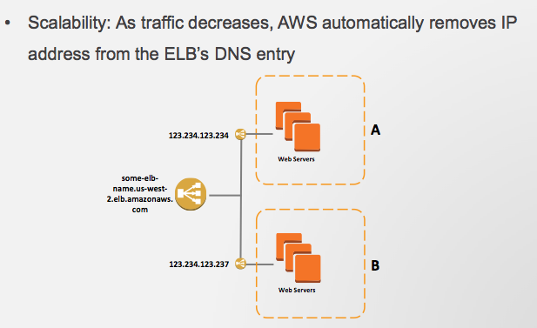
Amazon Elastic Load Balancer (ELB)

Slide 9
Auto Scaling
Auto Scaling is an Amazon service
Scale your Amazon EC2 capacity up or down automatically according to conditions you define
Ensure that the number of EC2 instances you’re using increases seamlessly during demand spikes to maintain performance, and decreases automatically during lulls to minimize costs

Slide 10
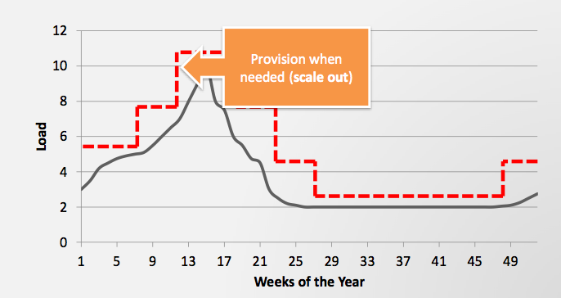
Auto Scaling

Slide 11
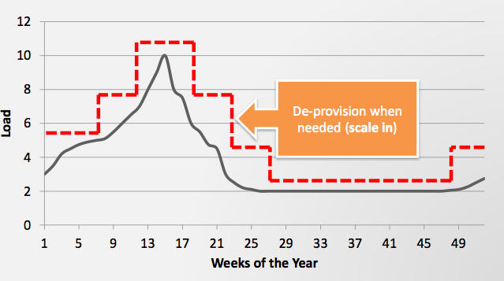
Auto Scaling

Slide 12
How to Scale
Manual scaling is bad
Slow to react
Need someone to be on-call all the time
Need to make scaling automatic

Slide 13
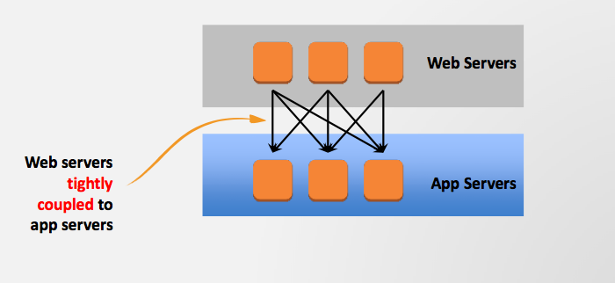
Tightly Coupled
Tightly coupled is bad
Application components in which a single unit depends on another specific single unit behave poorly when the dependency fails or needs to be subdivided to scale.
For example web server has to be told that there is a new application server available

Slide 14
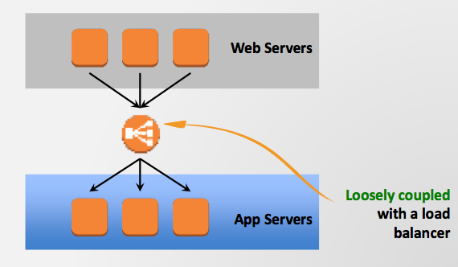
Loosely-coupled
The load balancer in the above example acts as an intermediary between the web server and one or more app servers
Can start up another app server and the web server does not need to know about it
The load balancer distributes the traffic accordingly

Slide 15
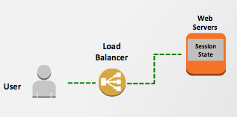
Maintain State is Bad
Applications that store state on one instance are more challenging to scale horizontally.
Keeping the session information in a particular Web server is bad since it means the user can not be easily moved to another server to reduce load

Slide 16
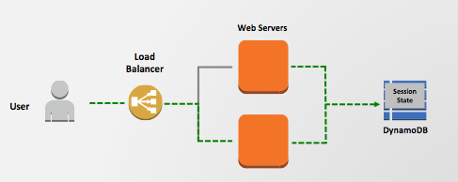
Better solution
Move state to a shared, accessible location
E.g. DynamoDB noSQL store or the relational database service (RDS)
Stateless application servers
Any instance can access the state of the activity at anytime.

